Slide 1
B V RAJU INSTITUTE OF TECHNOLOGY (UGC Autonomous) Vishnupur, Narsapur, Medak District
Department of Computer Science and Engineering
Minor Project – First Review
Title : Recti Cure – Detecting Cataract Disorder
By:
A Sai charan
Aniketh Goje
B Archana
A Aarin
Guided By:
Dr. Lanke Pallavi
Associate HOD

Slide 2
Outline
Overview of 1st Review
Recommendations & Suggestions by panel in 1st Review.
Implementation Screen Shots (Module wise)
Results and Discussion
Comparative Study

Slide 3
Overview of 1st Review
Aim of the project is to develop a web application that will detect cataract disorder in provided fundus image and suggest treatment to the user accordingly if cataract is detected.
Explored on Proposed VGG-19 Architecture.
Obtained the dataset that is required for the model development.
Made 3 levels of DFD diagrams and some of the UML diagrams for the proposed model which helped us for better understanding.
Explored about existing models and their accuracies of results.

Slide 4
Recommendations & Suggestions by panel in 1st Review.
S.NO | Recommendations & Suggestions given by panel | Changes made by Project Team as per suggestions
1 | Explore the procedure through which the model get trained. | Exploration and implementation on training is done.
2 | Work on implementation of VGG model | VGG architecture explored and implementation is almost done.
3 | Explore how to test the accuracy of model | Explored and process is under progress.

Slide 5

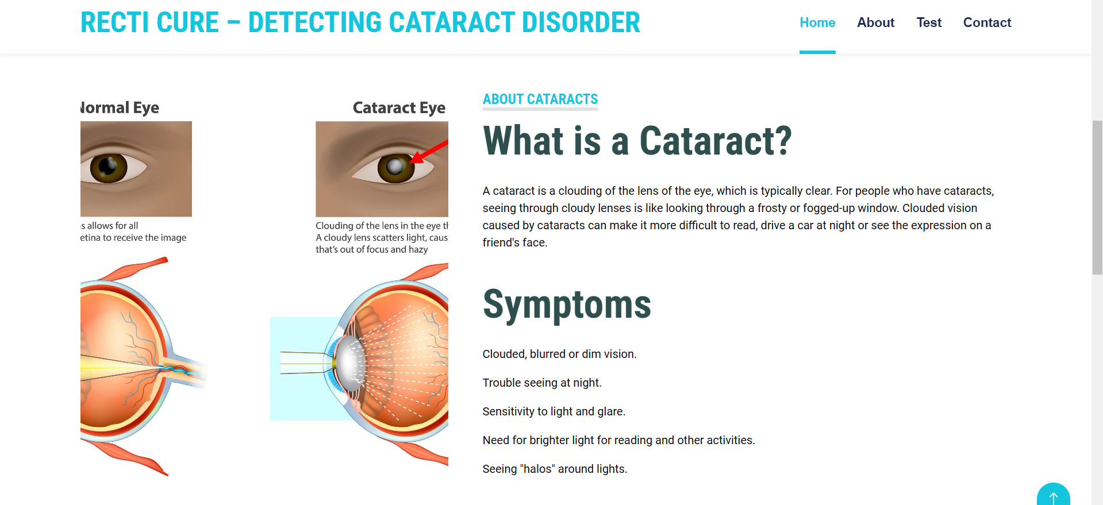
Implementation Screen Shots (Module wise)

Slide 6
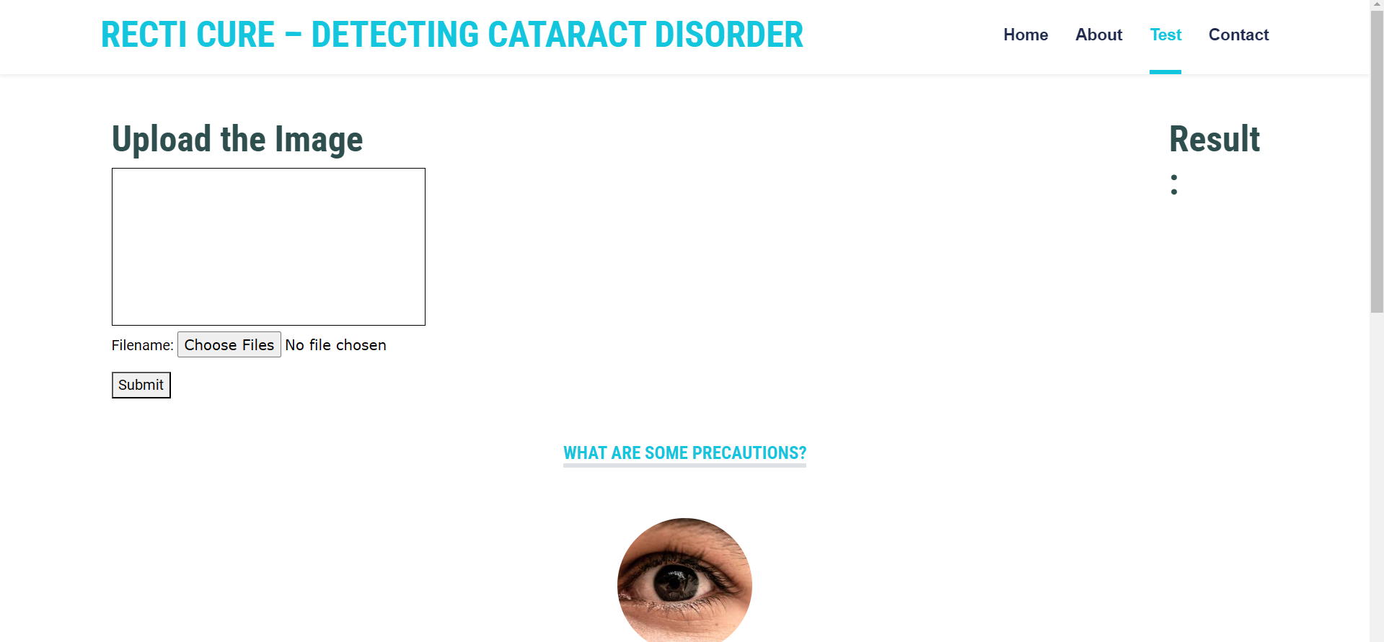
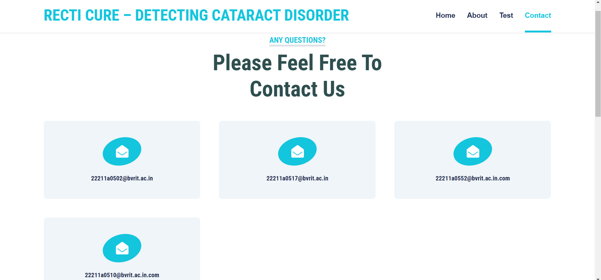
Implementation Screen Shots (Module wise)

Slide 7
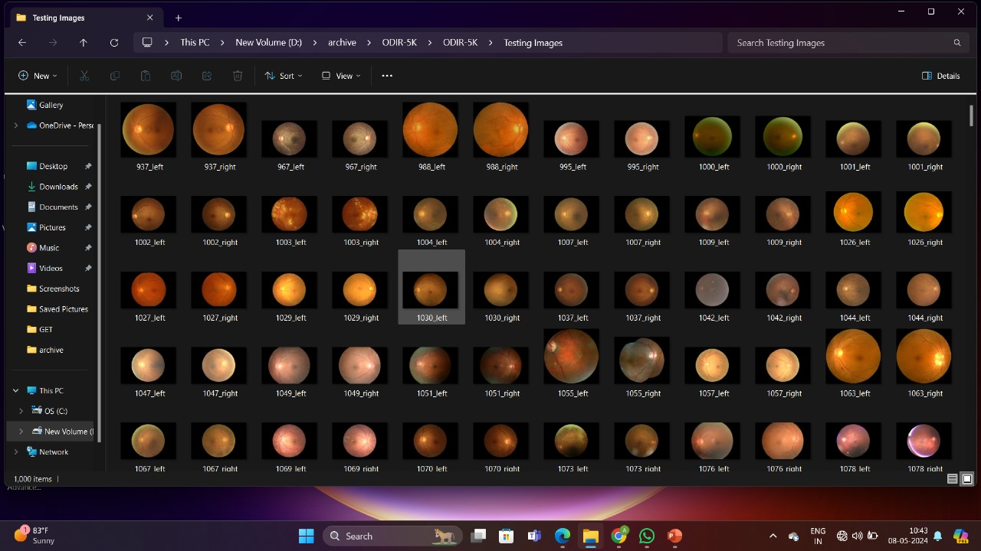
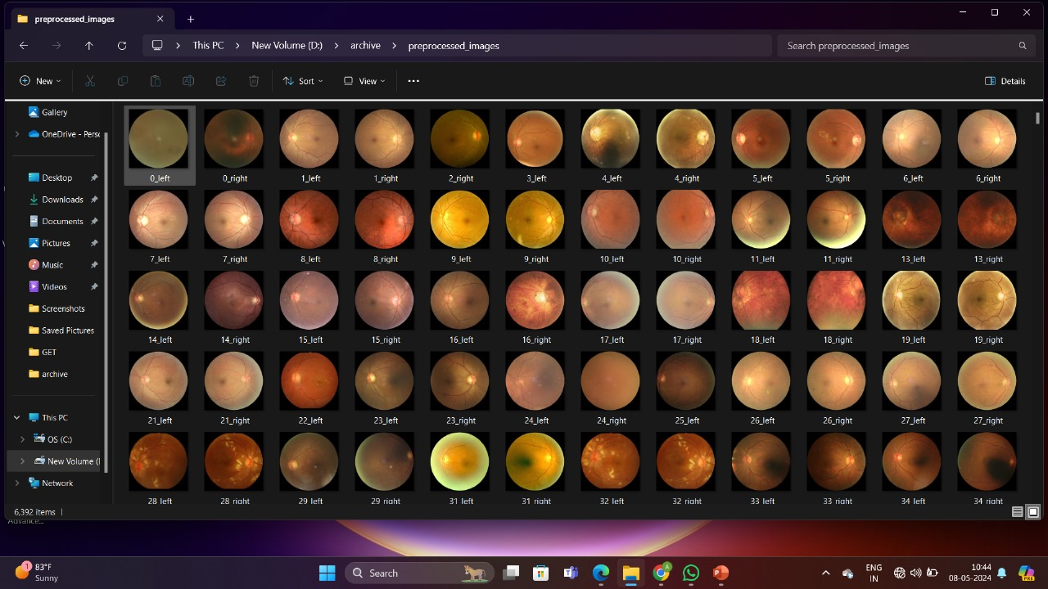
Implementation Screen Shots (Module wise)
Model Training Images
Preprocessed Images

Slide 8
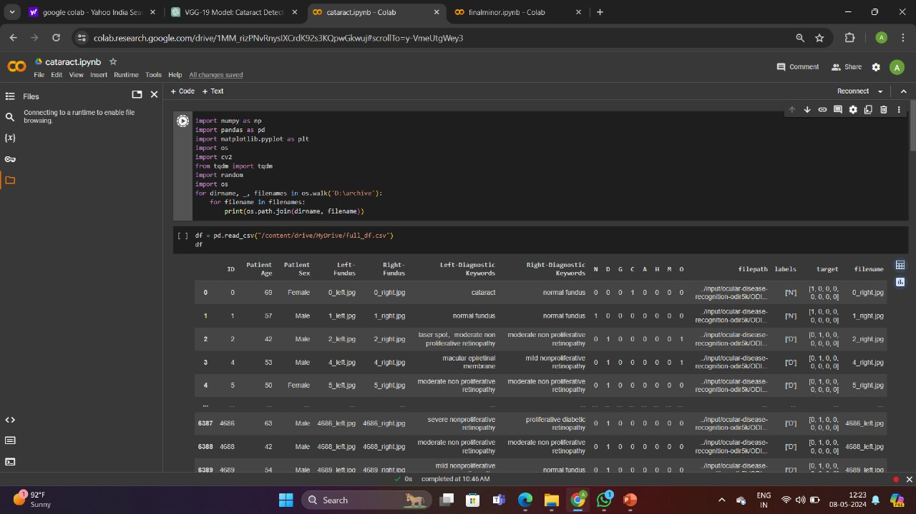
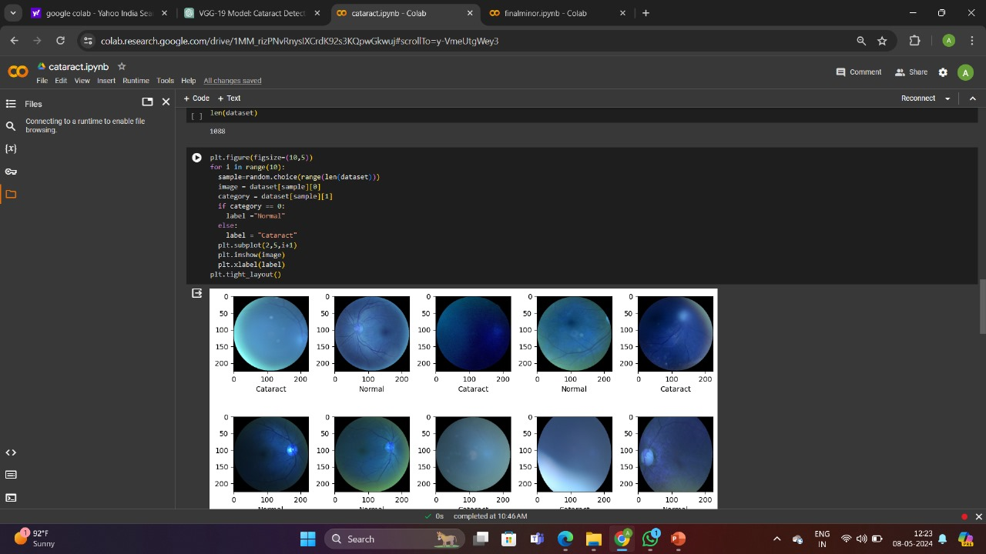
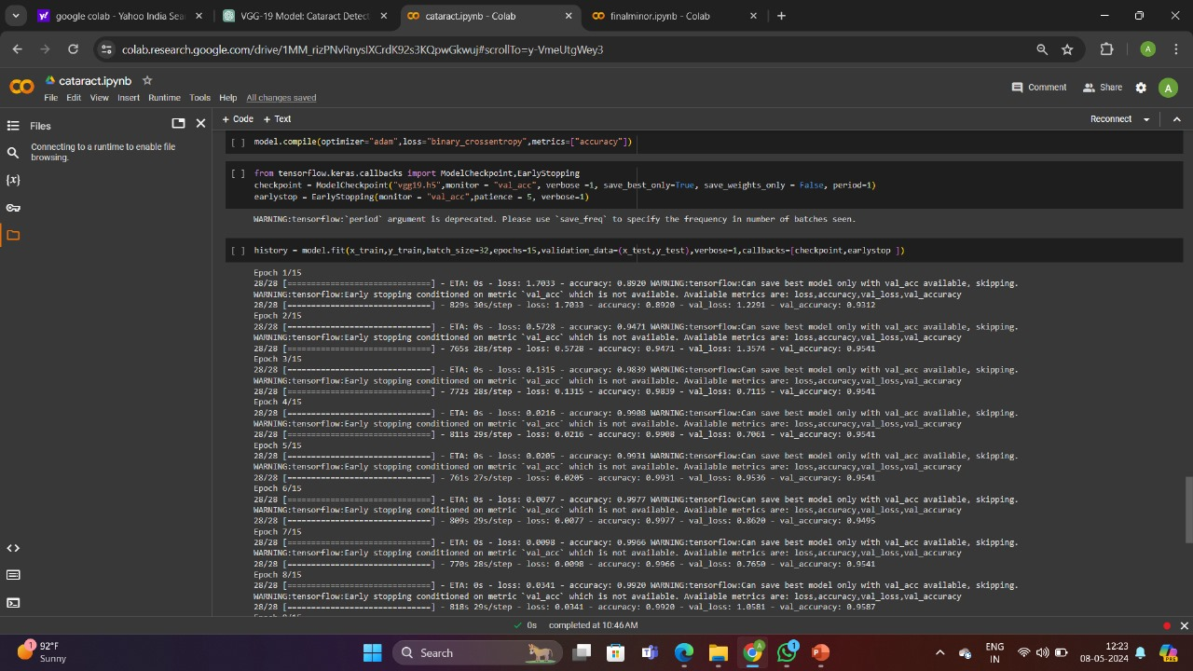
Implementation Screen Shots (Module wise)

Slide 9
Results and Discussion
Developed a web application that will detect cataract disorder in provided fundus image and suggest treatment to the user accordingly if cataract is detected.
The VGG 19 architecture is based on Deep Learning neural networks which has 19 convolutional layers. Its application in image classification tasks.
It is better than the VGG 16 model which was being used previously. This model is trained and includes the callbacks named ModelCheckpoint and EarlyStopping.
The Website provides educational content on Cataract disorder. It is dedicated with a page called “/Test” where on uploading an image of eye (to be checked) we get cataract results.
The Deep learning model VGG 19 is trained to return better and accurate results with minimum loss.

Slide 10
Comparative Study
This web application will helps the user to self detect cataract and get related information instead of waiting for hours in hospital waiting rooms for report.
This architecture is known for its simplicity and uniformity that makes easy to understand and implement.
VGG-19 is deeper than many earlier CNN architectures and it consists of 16 convolutional layers and 3 fully connected layers including 5 max pooling layers.
As we know deeper networks have potential to capture more complex. Hence results in leading to better performance.
VGG-19 achieves competitive performance on image classification compared to other models.
Date: Saturday, 8th July

Slide 11
References
[1] T. Pratap and P. Kokil, “Computer-aided diagnosis of cataract using deep transfer learning,” Biomedical Signal Processing and Control, vol. 53, p. 101533, Aug. 2019, doi: 10.1016/j.bspc.2019.04.010.
[2] L. Guo, J.-J. Yang, L. Peng, J. Li, and Q. Liang, “A computeraided healthcare system for cataract classification and grading based on fundus image analysis,” Computers in Industry, vol. 69, pp. 72–80, May 2015, doi: 10.1016/j.compind.2014.09.005. 2023, doi: 10.3390/jimaging9100197
[3] T. Ganokratanaa, M. Ketcham, and P. Pramkeaw, “Advancements in Cataract Detection: The Systematic Development of LeNetConvolutional Neural Network Models,” J. Imaging, vol. 9, no. 10, p. 197, Sep. 2023, doi: 10.3390/jimaging9100197.
[4] S . Yadav and J. K. P. S. Yadav, “Enhancing Cataract Detection Precision: A Deep Learning Approach,” TS, vol. 40, no. 4, pp. 1413–1424, Aug. 2023, doi: 10.18280/ts.400410.
[5] H. Morales-Lopez, I. Cruz-Vega, and J. Rangel-Magdaleno, “Cataract Detection and Classification Systems Using Computational Intelligence: A Survey,” Arch Computat Methods Eng, vol. 28, no. 3, pp. 1761–1774, May 2021, doi: 10.1007/s11831-020-09440-2.
[6] Md. Sajjad Mahmud Khan, Mahiuddin Ahmed, Raseduz Zaman Rasel, Mohammad Monirujjaman Khan, ”Cataract Detection Using Convolutional Neural Network with VGG-19 Model”
[7] R. U. Acharya, W. Yu, K. Zhu, J. Nayak, T.-C. Lim, and J. Y. Chan, “Identification of Cataract and Postcataract Surgery Optical Images Using Artificial Intelligence Techniques,” J Med Syst, vol. 34, no. 4, pp. 619–628, Aug. 2010, doi: 10.1007/s10916-009-9275-8
[8] V. Agarwal, V. Gupta, V. M. Vashisht, K. Sharma, and N. Sharma, “Mobile Application Based Cataract Detection System,” in 2019 3rd International Conference on Trends in Electronics and Informatics (ICOEI), Tirunelveli, India: IEEE, Apr. 2019, pp. 780–787. doi: 10.1109/ICOEI.2019.8862774

Slide 12
References
[9] I. Weni, P. E. P. Utomo, B. F. Hutabarat, and M. Alfalah, “Detection of Cataract Based on Image Features Using Convolutional Neural Networks,” Indonesian J. Comput. Cybern. Syst., vol. 15, no. 1, p. 75, Jan. 2021, doi: 10.22146/ijccs.61882
[10] V. Agarwal, V. Gupta, V. M. Vashisht, K. Sharma, and N. Sharma, “Mobile Application Based Cataract Detection System,” in 2019 3rd International Conference on Trends in Electronics and Informatics (ICOEI), Tirunelveli, India: IEEE, Apr. 2019, pp. 780–787. doi: 10.1109/ICOEI.2019.8862774
[11] X. Gao, S. Lin, and T. Y. Wong, “Automatic Feature Learning to Grade Nuclear Cataracts Based on Deep Learning,” IEEE Trans. Biomed. Eng., vol. 62, no. 11, pp. 2693–2701, Nov. 2015, doi: 10.1109/TBME.2015.2444389.
[12] Junayed, M., Islam, M., Sadeghzadeh, A. Rahman, S. (2021) CataractNet: An Automated Cataract Detection System Using Deep Learning for Fundus Images. IEEE ACCESS , 9(None), 128799-128808.
[13] J.-J. Yang et al., “Exploiting ensemble learning for automatic cataract detection and grading,” Computer Methods and Programs in Biomedicine, vol. 124, pp. 45–57, Feb. 2016, doi: 10.1016/j.cmpb.2015.10.007
[14] X. Xu, L. Zhang, J. Li, Y. Guan, and L. Zhang, “A Hybrid Global-Local Representation CNN Model for Automatic Cataract Grading,” IEEE J. Biomed. Health Inform., vol. 24, no. 2, pp. 556–567, Feb. 2020, doi: 10.1109/JBHI.2019.2914690.
[15] J. H. L. Goh et al., “Artificial Intelligence for Cataract Detection and Management,” Asia-Pacific Journal of Ophthalmology, vol. 9, no. 2, pp. 88–95, Mar. 2020, doi: 10.1097/01.APO.0000656988.16221.04
Date: Saturday, 8th July

Slide 13
Thank You ………..

